Slide 1

A Project presentation on AN EXPLAINABLE ENSEMBLE LEARNING MODEL FOR ROBUST LOAN APPROVAL SYSTEM
Presented by Batch 07 – B5
Allam Gowri Shankar 22101A010003
Kollamgunta Rohith 22101A010233
Naga Venkata Sai Praneeth 22101A010455
Sivakumar Likhitha 22101A010582
Computer Science and Engineering ( Artificial Intelligence and Machine Learning)
Under the guidance of
Kaluva Jaya Deepthi,
Assistant Professor,
Dept. of AIML.
Program Head
Dr. G. Sunitha,
Professor & Head,
Dept. of AIML.

Slide 2
Contents
Title
Abstract
Introduction
Problem Statement
Objectives
Existing Work
Proposed Work
Modules Explanation
Results and Discussion
Conclusion
Future Work
References

Slide 3
Abstract
Loan approval is an important process in banks and financial institutions, where decisions are usually made based on an applicant’s financial details. Traditional methods often take more time and may include human errors or bias. Therefore, there is a need for an automated system that can make faster and more reliable decisions. In this work, a machine learning–based loan approval system is developed using applicant information such as income, CIBIL score, loan amount, employment status, and asset values. Different classification algorithms, including Logistic Regression, Decision Tree, Support Vector Machine, K-Nearest Neighbors, and Random Forest, are applied and compared. Among these models, Random Forest gives the best performance, achieving an accuracy of around 97–99% in predicting loan approval status. To make the system more transparent, Explainable Artificial Intelligence (XAI) techniques like SHAP (SHapley Additive exPlanations) and LIME (Local Interpretable Model-Agnostic Explanations) are used. These methods help in understanding how the model makes decisions by showing the importance of different features. This improves trust and makes the system easier to use in real-world applications. The proposed system provides accurate, fast, and explainable loan approval decisions, making it useful for modern financial institutions.
Keywords : Loan Approval System, Random Forest, Explainable AI (XAI), SHAP & LIME, Financial Decision-Making.

Slide 4
Introduction
Loan Approval Process (Traditional Approach).
Relies on human intervention and rule-based systems Loan evaluation is not fully automated. Bank officers review applications using predefined rules and their judgment
Time-consuming and inefficient process Human-involved verification and multi-level approval workflows lead to delays in processing loan applications.
Prone to human errors and bias Decisions may vary from one officer to another, leading to inconsistencies and potential unfairness.
Difficulty in handling increasing applications As the number of loan applications grows, the traditional approach struggles to maintain speed, accuracy, and consistency.

Slide 5
Introduction
Need for Machine Learning Based Decision System
Replace rule-based decision-making with data-driven models
Improve accuracy and consistency in predictions
Reduce dependency on manual judgment
Enable scalable processing of large datasets

Slide 6
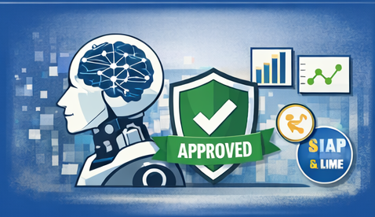
Introduction
Our Solution
Proposes a machine learning driven loan approval framework
Performs comparative analysis of multiple classification algorithms
Selects the optimal model based on evaluation metrics (~98% accuracy)
Incorporates Explainable AI (SHAP(SHapley Additive exPlanations) & LIME(Local Interpretable Model-Agnostic Explanations)) for model interpretability and transparency

Slide 7
Literature Study
S.No | Title | Methodology | Limitations
1 | Responsible AI in Loan Approval (2023) | Applied Explainable AI techniques to improve transparency in loan decision-making | Limited focus on model accuracy and performance comparison
2 | Enhanced Loan Approval Prediction (2025) | Used Machine Learning models for improving prediction accuracy | Lacks interpretability and explanation of decisions
3 | Process Evaluation of Loan Approval (2019) | Analyzed traditional loan approval workflows and suggested improvements | No implementation of AI or ML techniques
4 | Explainable AI for Loan Approval (2025) | Integrated XAI methods like SHAP and LIME with ML models | Computational complexity and increased processing time
5 | AI-based Credit Scoring Models (2025) | Developed AI models for credit risk assessment and financial inclusion | May suffer from bias due to data imbalance
CNN, deep belief network
(DBN) ResNet-50 RF, SVM, DNN
84%
71% 86.13%
CNN + Optic Disc / Cup Segmentation

Slide 8
Literature Study
S.No | Title | Methodology | Limitations
6 | Loan Approval Prediction using ML (2021) | Used classification algorithms like Logistic Regression and Decision Trees | Lower accuracy with complex datasets
7 | Neuro-based AI Model (2010) | Used Neural Networks for loan decision prediction | Lack of interpretability
8 | XAI for Credit Scoring (2025) | Combined ML models with Explainable AI techniques | Requires high computational resources
9 | AI-Driven Loan Approval Model (2024) | Implemented ML-based automated loan approval system | Limited dataset and scalability issues
10 | Future of Loan Approvals with XAI (2025) | Focused on integrating XAI into financial decision systems | Still in early-stage adoption, limited real-world validation

Slide 9
Problem Statement
“Existing loan approval systems rely on human intervention and rule-based or basic machine learning approaches, leading to inefficiencies, inconsistency, and potential bias. They also struggle to handle large volumes of applications and often lack transparency in decision-making, creating a need for accurate, fast, and explainable solutions in financial institutions.”

Slide 10
Objectives
Develop a machine learning–based loan approval system for accurate decision-making
Improve efficiency and speed of the loan approval process
Ensure consistency and reduce human bias through data-driven predictions
Identify the most effective model by comparing multiple algorithms
Enhance transparency using Explainable AI techniques (SHAP & LIME)
Enable scalable processing of large volumes of loan applications

Slide 11
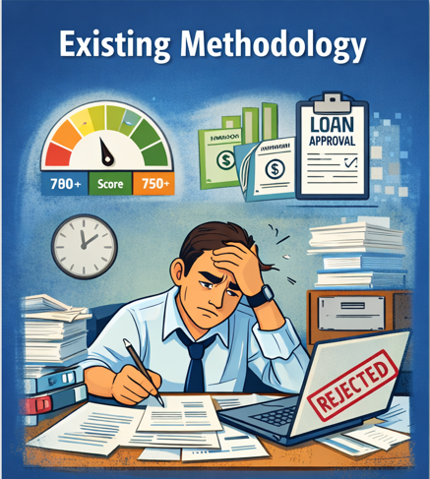
Existing Methodologies
Existing Methodologies
Loan approval involves human intervention along with rule-based systems
Decisions are based on key factors such as:
Income
Credit history
Employment status
Uses traditional statistical and scoring models
Relies significantly on human judgment and predefined rules
Limited use of advanced data-driven and explainable techniques

Slide 12
Existing Methodology Drawbacks
Time-consuming and inefficient due to human involvement and multiple processing steps
Prone to human errors and bias, affecting fairness and reliability
Difficulty in handling large volumes of loan applications efficiently
Inconsistent decision-making due to variation in human judgment
Lack of transparency in understanding how decisions are made
Limited scalability for modern high-volume financial environments

Slide 13
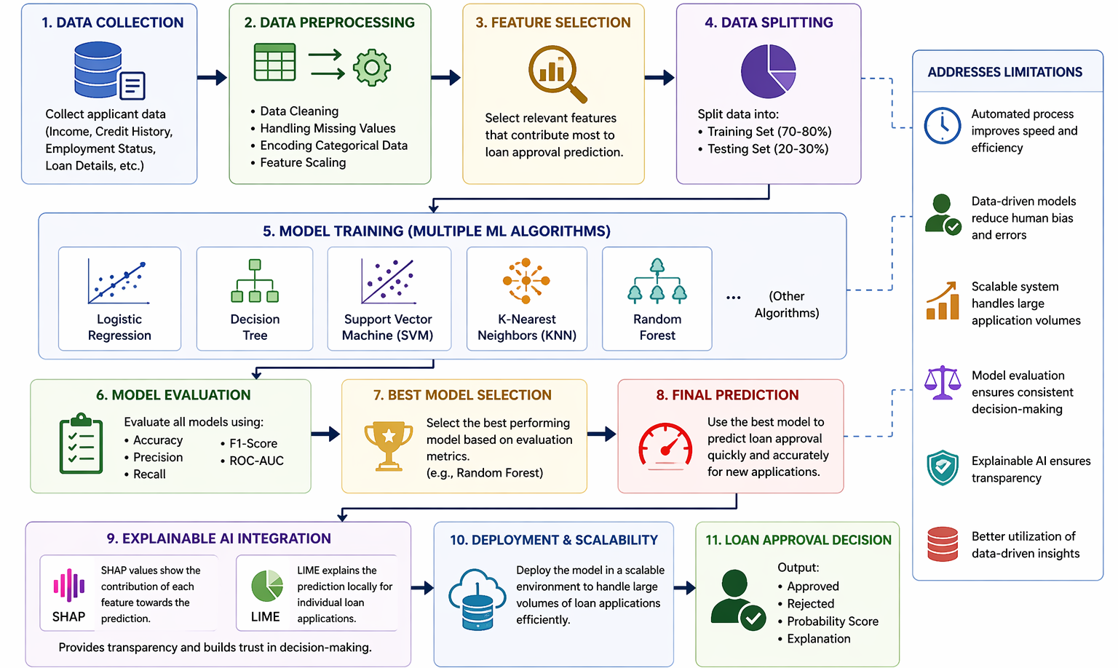
Proposed Methodology

Slide 14
Modules Explanation
1. Input Data Module
Collects applicant details such as income, CIBIL score, loan amount, employment status, and assets to enable data-driven decision-making.
2. Data Preprocessing Module
Cleans and prepares the data by handling missing values, encoding categorical variables, and scaling features to ensure accuracy and consistency.
3. Dataset Splitting Module
Divides the dataset into training (80%) and testing (20%) sets to ensure the model can generalize well to new data.
4. Model Training Module
Trains multiple machine learning algorithms (Logistic Regression, Decision Tree, SVM, KNN, Random Forest) to learn patterns and reduce bias.

Slide 15
Modules Explanation
5. Model Evaluation Module
Evaluates models using metrics like accuracy, precision, recall, and F1-score to ensure reliable and consistent performance.
6. Best Model Selection Module
Selects the best-performing model (Random Forest) based on evaluation results for optimal prediction accuracy.
7. Prediction Module
Uses the selected model to make fast and efficient loan approval decisions (Approved/Rejected).
8. Explainable AI Module (SHAP & LIME)
Provides transparent and interpretable explanations by showing how each feature influences the prediction.

Slide 16
Hardware & Software Specifications
Hardware Requirements:
Processor: Intel i5 / i7 or higher
RAM: Minimum 8 GB (16 GB recommended)
Storage: 256 GB SSD / 500 GB HDD
System Type: 64-bit Operating System
Device: Laptop/Desktop

Slide 17
Software Requirements:
Programming Language: Python
Environment: Jupyter Notebook / Google Colab
Libraries:
NumPy
Pandas
Scikit-learn
Matplotlib / Seaborn
Operating System: Windows / Linux / macOS

Slide 18
Results
Multiple machine learning models were evaluated for loan prediction
Random Forest achieved the best performance among all models
Achieved high accuracy of ~98%
Shows high precision and recall, ensuring reliable predictions
Minimal misclassification observed in confusion matrix
System effectively predicts loan approval (Approved/Rejected)
Key factors influencing results:
Cibil Score
Income
Loan Amount
Accuracy: 98.12% | Precision: 99.35% | Recall: 95.66% | F1-score: 97.47%

Slide 19
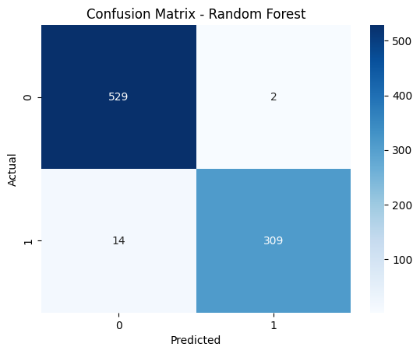
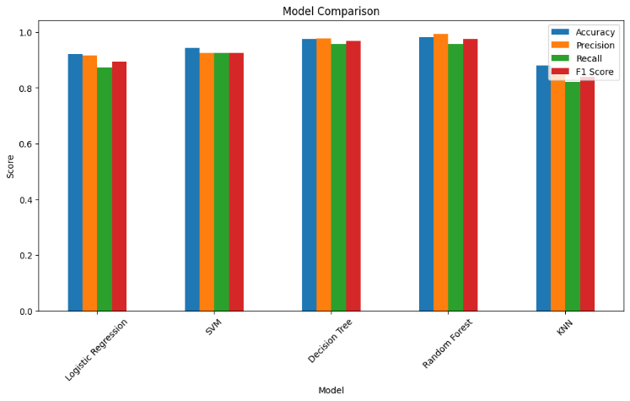
Results
Graph 1: Model Performance Comparison Across Evaluation Metrics
Graph 2: Confusion Matrix for Loan Prediction Model.

Slide 20
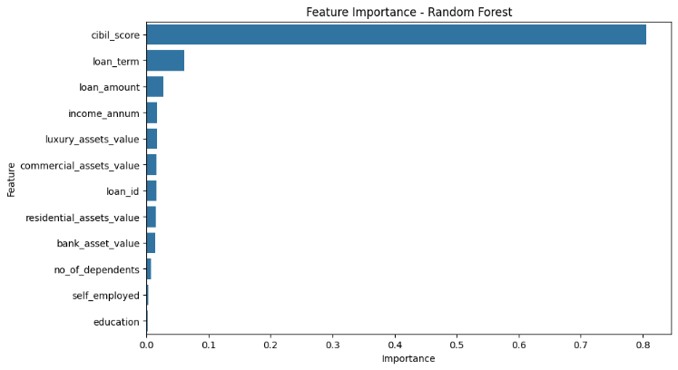
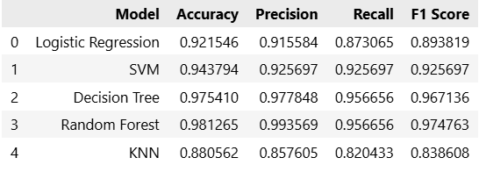
Results
Comparison of multiple machine learning models showing Random Forest achieves the best overall performance in loan approval prediction.
Graph3: Feature Importance Analysis for Loan Approval Prediction

Slide 21
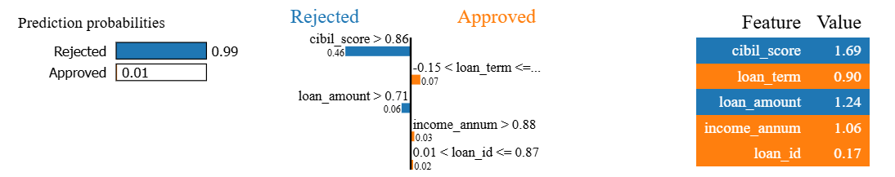
Results
This figure explains how different features influence the model’s decision, showing whether the loan was Accepted/ Rejected.

Slide 22
Conclusion
Developed a machine learning–based loan approval system for data-driven decision-making
Addressed key limitations of existing systems such as inefficiency, bias, lack of scalability, and limited transparency
Evaluated multiple models and identified Random Forest as the best-performing algorithm (~98% accuracy)
Achieved high precision and recall, ensuring reliable and consistent predictions
Integrated Explainable AI (SHAP & LIME) to enhance transparency and trust
Designed a system that is efficient, scalable, and suitable for real-world financial applications.

Slide 23
Future Work
Use larger and more diverse datasets for better accuracy
Include additional features like:
Transaction history
Behavioral and spending patterns
Explore Deep Learning and Hybrid Models
Implement real-time loan approval system
Enhance Explainable AI techniques for better insights
Deploy as a web or mobile application
Integrate with banking systems for live data processing

Slide 24
References
Purificato, E., Lorenzo, F., Fallucchi, F., & De Luca, E. W. (2023). Responsible Artificial Intelligence in Loan Approval Processes. International Journal of Human–Computer Interaction.
Shrivastava, V. K., et al. (2025). Enhanced Bank Loan Approval Prediction using Machine Learning. AI-Driven Competitive Intelligence and Next-Generation Security.
Kumari, J. R., et al. (2025). Transforming Loan Approval Processes using Explainable AI. International Journal of Communication Networks and Information Security.
Singh, J., et al. (2024). AI-Driven Loan Approval Model. International Conference on Smart Computing and Informatics.
Salaheldin, Y., et al. (2025). Data-Driven Model for Loan Approval Prediction using Machine Learning. ERU Research Journal.

Slide 25
Thank You

